Slide 1
Surface Area and Volume of Solids
Geometry
Chapter 12
Notes:
Geometry 12

Slide 2
This Slideshow was developed to accompany the textbook
Larson Geometry
By Larson, R., Boswell, L., Kanold, T. D., & Stiff, L.
2011 Holt McDougal
Some examples and diagrams are taken from the textbook.
Slides created by
Richard Wright, Andrews Academy
rwright@andrews.edu

Slide 3
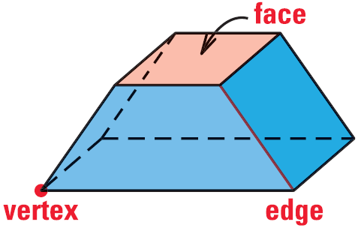
12.1 Explore Solids
Polyhedron
Solid with polygonal sides
Flat sides
Face
Side
Edge
Line segment
Vertex
Corner

Slide 4
12.1 Explore Solids
Prism
Polyhedron with two congruent surfaces on parallel planes (the 2 ends (bases) are the same)
Named by bases (i.e. rectangular prism, triangular prism)
Cylinder
Solid with congruent circular bases on parallel planes (not a polyhedron)

Slide 5
12.1 Explore Solids
Pyramid → polyhedron with all but one face intersecting in one point
Cone → circular base with the other surface meeting in a point (kind of like a pyramid)
Sphere → all the points that are a given distance from the center

Slide 6
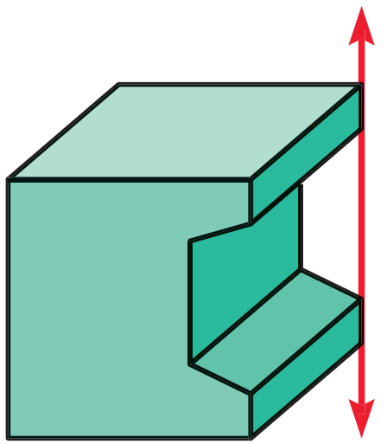
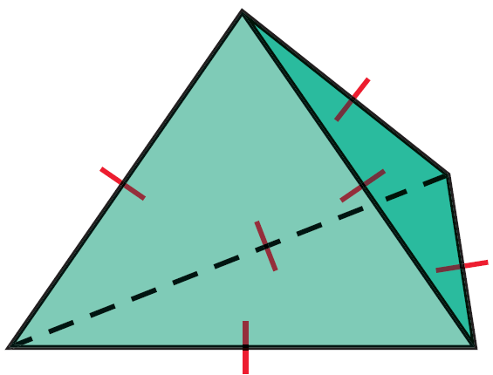
12.1 Explore Solids
Euler’s Theorem
The number of faces (F), vertices (V), and edges (E) of a polyhedron are related by
$$F+V=E+2$$
Convex
Any two points can be connected with a segment completely inside the polyhedron
Concave
Not convex
Has a “cave”

Slide 7
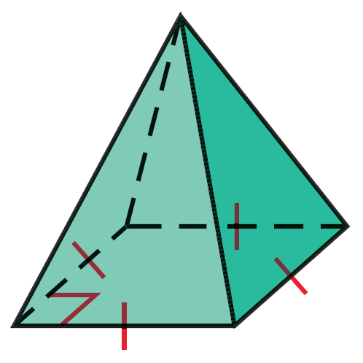
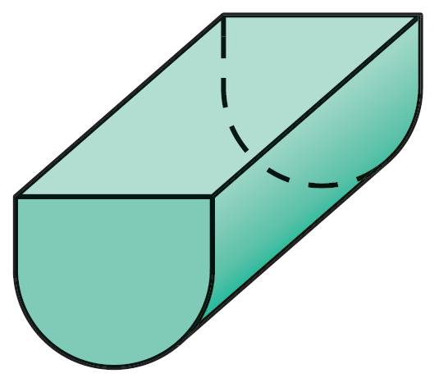
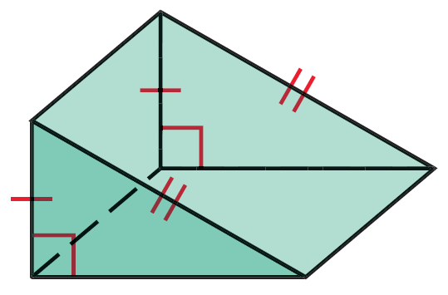
12.1 Explore Solids
Tell whether the solid is a polyhedron. If it is, name the polyhedron and find the number of faces, vertices, and edges and describe as convex or concave
Notes:
Polyhedron; Square Pyramid; 5 faces, 5 vertices, 8 edges; convex
Not a Polyhedron
Polyhedron; Triangular Prism; 5 faces, 6 vertices, 9 edges; convex

Slide 8
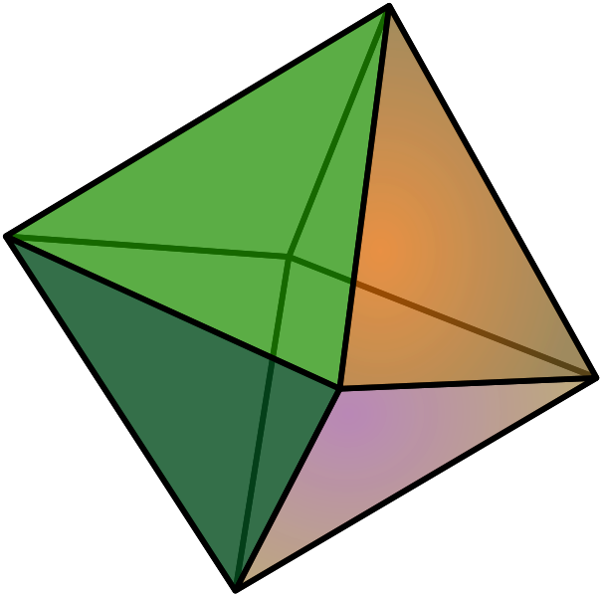
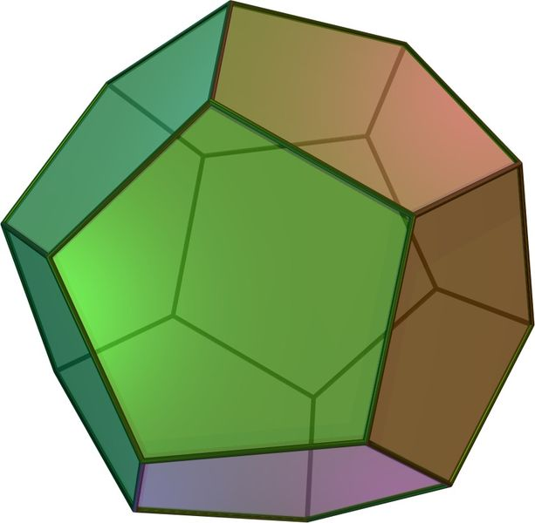
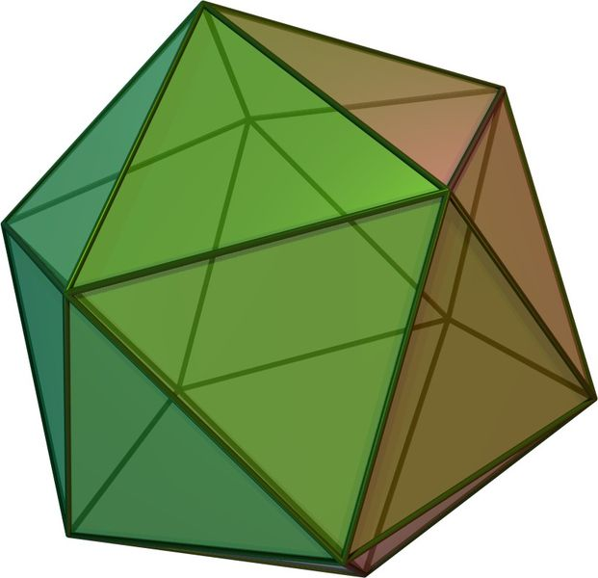
12.1 Explore Solids
Regular polyhedron
Polyhedron with congruent regular polygonal faces
Only 5 types (Platonic solids)
Tetrahedron → 4 faces (triangular pyramid)
Hexahedron → 6 faces (cube)
Octahedron → 8 faces (2 square pyramids put together)
Dodecahedron → 12 faces (made with pentagons)
Icosahedron → 20 faces (made with triangles)

Slide 9
12.1 Explore Solids
Cross Section
Imagine slicing a very thin slice of the solid
The cross section is the 2-D shape of the thin slice

Slide 10
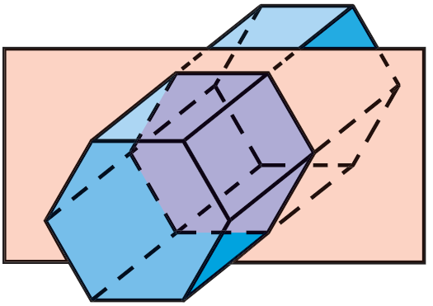
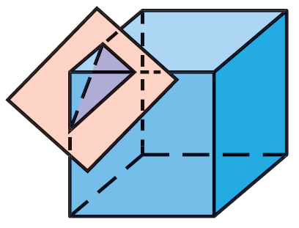
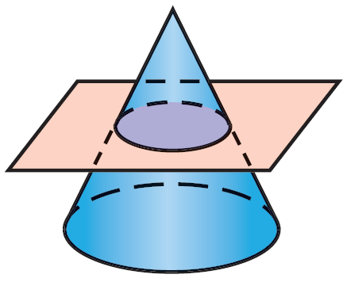
12.1 Explore Solids
Find the number of faces, vertices, and edges of a regular dodecahedron. Check with Euler’s Theorem.
Describe the cross section.
798 #2-40 even, 44-60 even = 29
Notes:
Triangle
Circle
Hexagon

Slide 11
Answers and Quiz
12.1 Answers
12.1 Homework Quiz

Slide 12
12.2 Surface Area of Prisms and Cylinders
Surface area = sum of the areas of each surface of the solid
In order to calculate surface area it is sometimes easier to draw all the surfaces
Notes:
Some sports relie on having very little friction. In biking for example, the smaller the surface area of the tires, the less friction there is. And thus the faster the rider can go.
→ Draw the top triangle first (for some triangles you may have to count a horizontal space as 2)

Slide 13
12.2 Surface Area of Prisms and Cylinders
Nets
Imagine cutting the three dimensional figure along the edges and folding it out.
Start by drawing one surface, then visualize unfolding the solid.
To find the surface area, add up the area of each of the surfaces of the net.

Slide 14
12.2 Surface Area of Prisms and Cylinders
Parts of a right prism
Bases → parallel congruent surfaces (the ends)
Lateral faces → the other faces (they are parallelograms)
Lateral edges → intersections of the lateral faces (they are parallel)
Altitude → segment perpendicular planes containing the two bases with an endpoint on each plane
Height → length of the altitude
Base
Lateral Face
Lateral Edge
Altitude

Slide 15
12.2 Surface Area of Prisms and Cylinders
Right prism
Prism where the lateral edges are altitudes
Oblique prism
Prism that isn’t a right prism

Slide 16
12.2 Surface Area of Prisms and Cylinders
Lateral Area (L) of Prisms
Area of the Lateral Faces
L = Ph
L = Lateral Area
P = Perimeter of base
h = Height
Notes:
You can find the surface area by adding up the areas of each surface, but if you could use a formula, it would be quicker
All the lateral surfaces are rectangles
Area = bh
Add up the areas L = ah + bh + ch + … + dh
L = (a + b + c + … + d)h
Perimeter of base = a + b + c + … + d
L = Ph

Slide 17
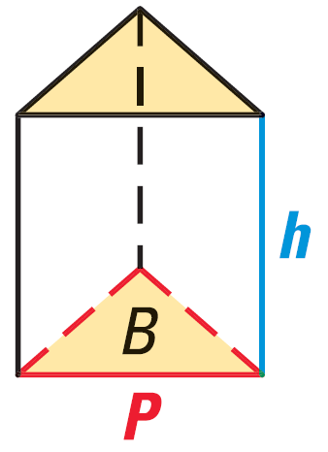
12.2 Surface Area of Prisms and Cylinders
Base Area (B)
In a prism, both bases are congruent, so you only need to find the area of one base and multiply by two
Surface Area of a Right Prism
$$S=2B+Ph$$
Where S = surface area, B = base area, P =
perimeter of base, h = height of prism

Slide 18
12.2 Surface Area of Prisms and Cylinders
Draw a net for a triangular prism.
Find the lateral area and surface area of a right rectangular prism with height 7 inches, length 3 inches, and width 4 inches.
Notes:
/\


$$P=2\left(3\right)+2\left(4\right)=14$$
$$L=\left(14\right)\left(7\right)=98$$
$$B=3⋅4=12$$
$$A=2\left(12\right)+14\left(7\right)=122$$

Slide 19
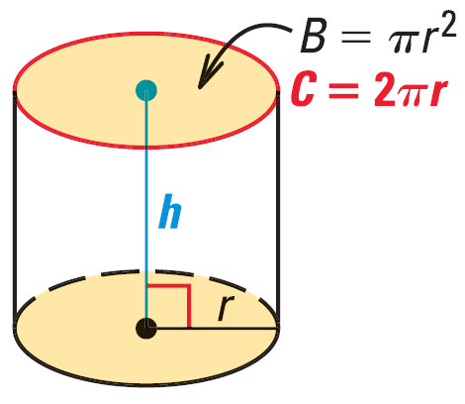
12.2 Surface Area of Prisms and Cylinders
Cylinders are the same as prisms except the bases are circles
Lateral Area = L = 2πrh
Surface Area of a Right Cylinder
$$S=2πr^{2}+2πrh$$
Where S = surface area, r = radius of base,
h = height of prism

Slide 20
12.2 Surface Area of Prisms and Cylinders
The surface area of a right cylinder is 100 cm². If the height is 5 cm, find the radius of the base.
Example: Draw a net for the cylinder and find its surface area.
806 #2-28 even, 31-37 all = 21
2
5
Notes:
$$100=2πr^{2}+2πr\left(5\right)$$
$$100=2πr^{2}+10πr$$
$$0=2πr^{2}+10πr−100$$
$$0=r^{2}+5r−15.915$$
$$r=\frac{−5±\sqrt{5^{2}−4\left(1\right)\left(−15.915\right)}}{2\left(1\right)}$$
$$r=\frac{−5±\sqrt{88.662}}{2}$$
$$r=2.2, −7.2$$
Only 2.2 makes sense because the radius must be positive
$$S=2π2^{2}+2π\left(2\right)\left(5\right)$$
$$S=8π+20π=28π$$

Slide 21
Answers and Quiz
12.2 Answers
12.2 Homework Quiz

Slide 22
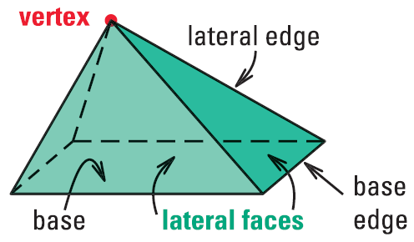
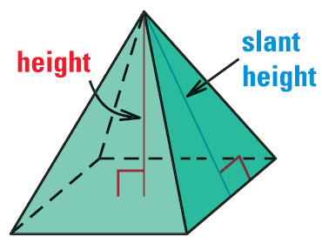
12.3 Surface Area of Pyramids and Cones
Pyramids
All faces except one intersect at one point called vertex
The base is the face that does not intersect at the vertex
Lateral faces → faces that meet in the vertex
Lateral edges → edges that meet in the vertex
Altitude → segment that goes from the vertex and is perpendicular to the base

Slide 23
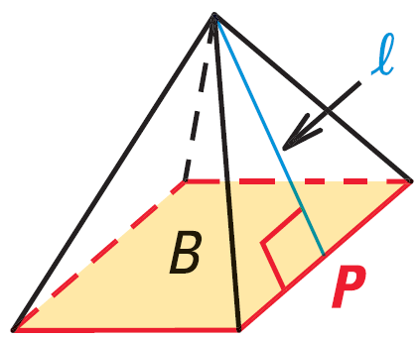
12.3 Surface Area of Pyramids and Cones
Regular pyramid → base is a regular polygon and the vertex is directly above the center of the base
In a regular pyramid, all the lateral faces are congruent isosceles triangles
The height of each lateral face is called the slant height (ℓ)
Lateral Area → L = ½ Pℓ
Surface Area of a Regular Pyramid
$$S=B+\frac{1}{2}Pℓ$$
Where B = base area, P = base perimeter, ℓ = slant height
Notes:
Lateral area is ½ because the sides are triangles.

Slide 24
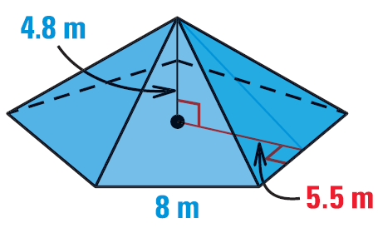
12.3 Surface Area of Pyramids and Cones
Find the surface area of the regular pentagonal pyramid.
Notes:
Base Area
$$B=\frac{1}{2}Pa$$
$$B=\frac{1}{2}\left(5⋅8\right)\left(5.5\right)=110$$
$$ℓ^{2}={5.5}^{2}+{4.8}^{2}$$
$$ℓ=7.3$$
$$S=B+\frac{1}{2}Pℓ$$
$$S=110+\frac{1}{2}\left(5⋅8\right)\left(7.3\right)=256$$

Slide 25
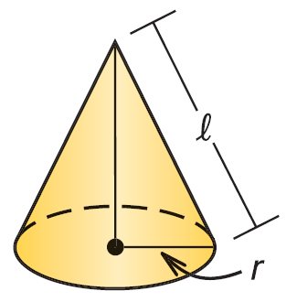
12.3 Surface Area of Pyramids and Cones
Cones
Cones are just like pyramids except the base is a circle
Lateral Area = πrℓ
Surface Area of a Right Cone
$$S=πr^{2}+πrℓ$$
Where r = base radius, ℓ = slant height

Slide 26
12.3 Surface Area of Pyramids and Cones
Example: The So-Good Ice Cream Company makes Cluster Cones. For packaging, they must cover each cone with paper. If the diameter of the top of each cone is 6 cm and its slant height is 15 cm, what is the area of the paper necessary to cover one cone?
814 #2-32 even, 35-39 all = 21
Extra Credit 817 #2, 6 = +2
Notes:
Looking for lateral area.
$$L=π3\left(15\right)=141.4 cm^{2}$$

Slide 27
Answers and Quiz
12.3 Answers
12.3 Homework Quiz

Slide 28
12.4 Volume of Prisms and Cylinders
Create a right prism using geometry cubes
Count the lengths of the sides
Count the number of cubes.
Remember this to verify the formulas we are learning today.

Slide 29
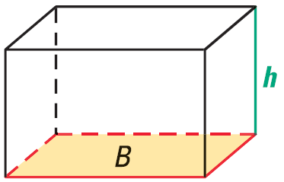
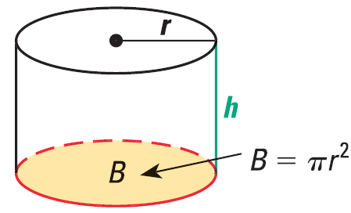
12.4 Volume of Prisms and Cylinders
Volume of a Prism
$$V=Bh$$
Where B = base area, h = height of prism
Volume of a Cylinder
$$V=πr^{2}h$$
Where r = radius, h = height of cylinder

Slide 30
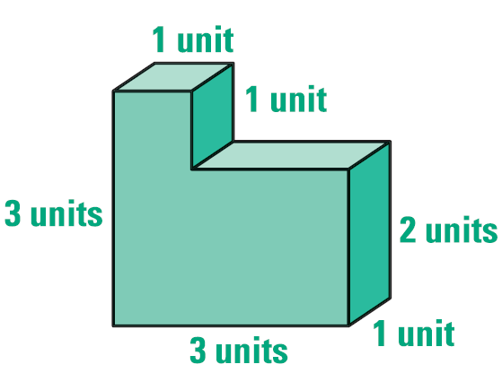
12.4 Volume of Prisms and Cylinders
Find the volume of the figure
Notes:
Cut into two prisms
Top
$$V=1\left(1\right)\left(1\right)=1$$
Bottom
$$V=3\left(1\right)\left(2\right)=6$$
Total
$$V=1+6=7$$

Slide 31
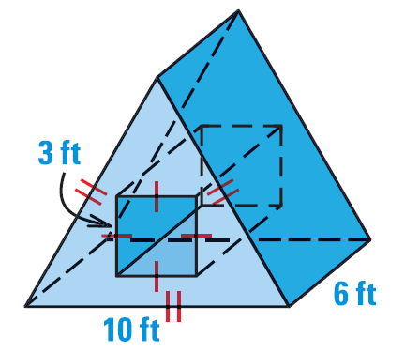
12.4 Volume of Prisms and Cylinders
Find the volume.
Notes:
Base Area (front)
Find height of triangle
$$5^{2}+x^{2}={10}^{2}$$
$$25+x^{2}=100$$
$$x^{2}=75$$
$$x=5\sqrt{3}$$
Area=triangle - square
$$B=\frac{1}{2}\left(10\right)\left(5\sqrt{3}\right)−3^{2}$$
$$B=25\sqrt{3}−9≈34.301$$
Volume = Bh
$$V=\left(25\sqrt{3}−9\right)\left(6\right)=150\sqrt{s}−54≈205.8$$

Slide 32
12.4 Volume of Prisms and Cylinders
There are 150 1-inch washers in a box. When the washers are stacked, they measure 9 inches in height. If the inside hole of each washer has a diameter of ¾ inch, find the volume of metal in one washer.
Notes:
Find volume of washers without holes: V = π ½² 9 = 7.06858
Find volume of hole: V = π(3/8)² 9 = 3.97608
Find volume of washers with holes: 7.06858 – 3.97608 = 3.09251
Find volume of one washer: 3.09251/150 = 0.02 in³

Slide 33
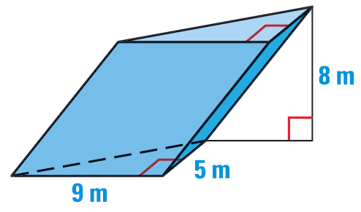
12.4 Volume of Prisms and Cylinders
Cavalieri’s Principle
If two solids have the same height and the same cross-sectional area at every level, then they have the same volume.
Find the volume.
822 #2-40 even = 20
Notes:
$$B=\frac{1}{2}\left(9\right)\left(5\right)=22.5 m^{2}$$
$$V=\left(22.5 m^{2}\right)\left(8 m\right)=180 m^{3}$$

Slide 34
Answers and Quiz
12. 4 Answers
12.4 Homework Quiz

Slide 35
12.5 Volume of Pyramids and Cones
How much ice cream will fill an ice cream cone?
How could you find out without filling it with ice cream?
What will you measure?

Slide 36
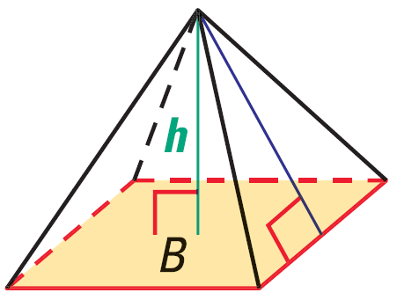
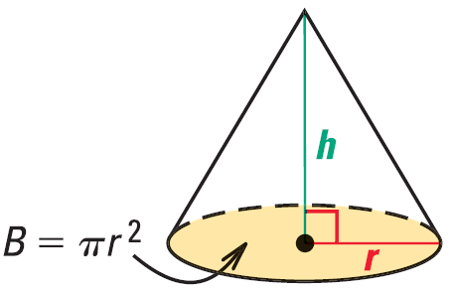
12.5 Volume of Pyramids and Cones
Volume of a Pyramid
$$V=\frac{1}{3}Bh$$
Where B = base area, h = height of pyramid
Volume of a Cone
$$V=\frac{1}{3}πr^{2}h$$
Where r = radius, h = height of cone

Slide 37
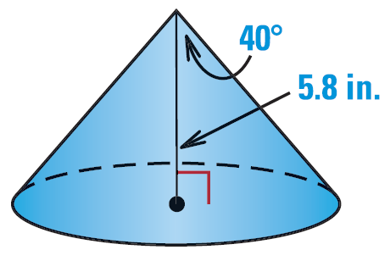
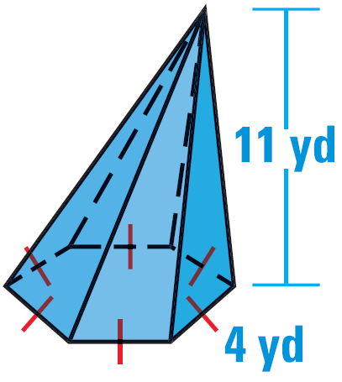
12.5 Volume of Pyramids and Cones
Find the volume.
832 #2-30 even, 34, 36, 40, 44-52 even = 23
Extra Credit 836 #2, 4 = +2
Notes:
$$B=\frac{1}{2}Pa$$
$$\frac{1}{2}central angle=\frac{1}{2}\left(\frac{360}{6}\right)=30$$
$$\tan{30}=\frac{2}{a}$$
$$a=\frac{2}{\tan{30}}=3.464$$
$$B=\frac{1}{2}\left(4⋅6\right)\left(3.464\right)=41.569$$
$$V=\frac{1}{3}\left(41.569\right)\left(11\right)=152.42$$
$$\tan{40}=\frac{r}{5.8}$$
$$r=5.8⋅\tan{40}=4.8668$$
$$V=\frac{1}{3}π{4.8668}^{2}⋅5.8=143.86$$

Slide 38
Answers and Quiz
12.5 Answers
12.5 Homework Quiz

Slide 39
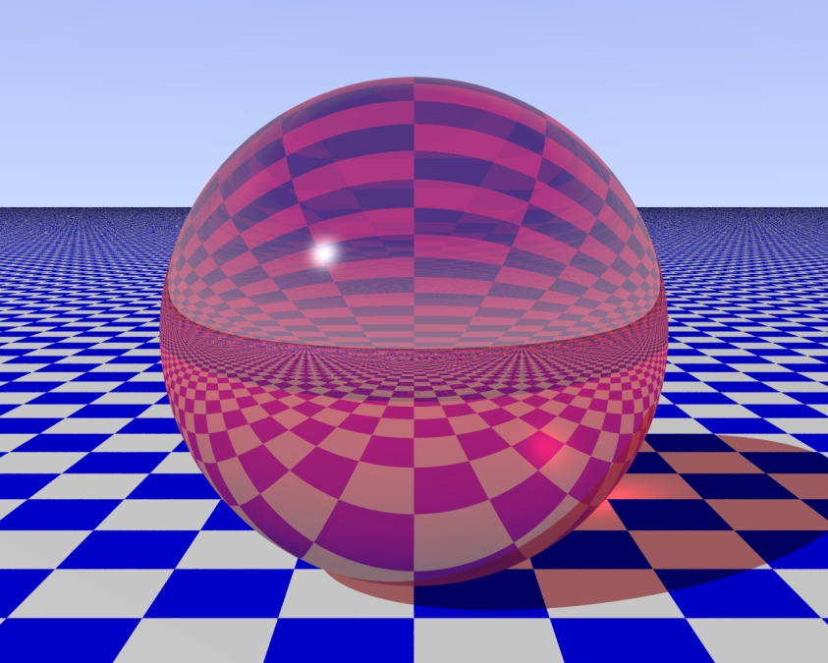
12.6 Surface Area and Volume of Spheres
Terms
Sphere → all points equidistant from center
Radius → segment from center to surface
Chord → segment that connects two points on the sphere
Diameter → chord contains the center of the sphere
Tangent → line that intersects the sphere in exactly one place

Slide 40
12.6 Surface Area and Volume of Spheres
Intersections of plane and sphere
Point → plane tangent to sphere
Circle → plane not tangent to sphere
Great Circle → plane goes through center of sphere (like equator)
Shortest distance between two points on sphere
Cuts sphere into two hemispheres

Slide 41
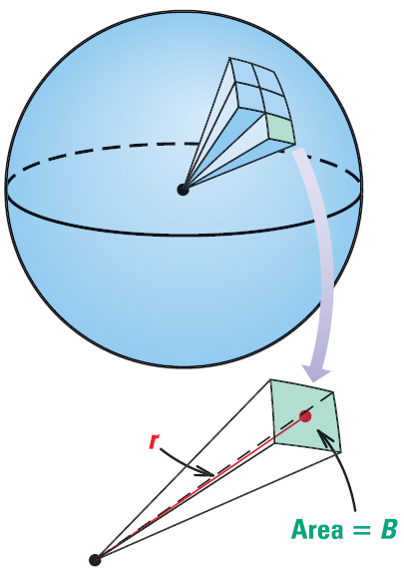
12.6 Surface Area and Volume of Spheres
Surface Area of a Sphere
$$S=4πr^{2}$$
Where r = radius
If you cut 4 circles into 8ths you can put them together to make a sphere
Volume of a Sphere
$$V=\frac{4}{3}πr^{3}$$
Where r = radius
Notes:
You can think about cutting a sphere into many small regular square pyramids.
V = 1/3 Bh → the area of all the bases is 4πr² and h = r

Slide 42
12.6 Surface Area and Volume of Spheres
Find the volume of the empty space in a box containing three golf balls. The diameter of each is about 1.5 inches. The box is 4.5 inches by 1.5 inches by 1.5 inches.
842 #2-36 even, 40-44 even = 21
Notes:
Volume of box: $4.5\left(1.5\right)\left(1.5\right)=10.125$
Volume of each ball: $\frac{4}{3}π.{75}^{3}=1.767$
Volume of empty space: $10.125−3\left(1.767\right)=4.824$

Slide 43
Answers and Quiz
12.6 Answers
12.6 Homework Quiz

Slide 44
12.7 Explore Similar Solids
Russian Matryoshka dolls nest inside each other. Each doll is the same shape, only smaller. The dolls are similar solids.

Slide 45
12.7 Explore Similar Solids
Similar Solids
Solids with same shape but not necessarily the same size
The lengths of sides are proportional
The ratios of lengths is called the scale factor

Slide 46
12.7 Explore Similar Solids
Congruent Solids
Similar solids with scale factor of 1:1
Following four conditions must be true
Corresponding angles are congruent
Corresponding edges are congruent
Areas of corresponding faces are equal
The volumes are equal

Slide 47
12.7 Explore Similar Solids
Determine if the following pair of shapes are similar, congruent or neither.
Cone A: r = 4.3, h = 12, slant height = 14.3
Cone B: r = 8.6, h = 25, slant height = 26.4
Ratios: $\frac{8.6}{4.3}=2$, $\frac{25}{12}=2.08$. Not proportional so neither
Right Cylinder A: r = 5.5, height = 7.3
Right Cylinder B: r = 5.5, height = 7.3
1:1 ratio so congruent.

Slide 48
12.7 Explore Similar Solids
Similar Solids Theorem
If 2 solids are similar with a scale factor of a:b,
then the areas have a ratio of a²:b²
and the volumes have a ratio of a³:b³

Slide 49
12.7 Explore Similar Solids
Cube C has a surface area of 216 square units and Cube D has a surface area of 600 square units. Find the scale factor of C to D.
Find the edge length of C.
Use the scale factor to find the volume of D.
850 #2-26 even, 30-48 even = 23
Extra Credit 854 #2, 4 = +2
Notes:
Areas: $\frac{216}{600}=\frac{9}{25}=\frac{c^{2}}{d^{2}}$
$\frac{c}{d}=\frac{\sqrt{9}}{\sqrt{25}}=\frac{3}{5}$
Cube surface area: $S={6c}^{2}$
$216={6c}^{2}$
$36=c^{2}$
$c=6$
Volumes: $\frac{c^{3}}{d^{3}}=\frac{3^{3}}{5^{3}}$
$\frac{6^{3}}{d^{3}}=\frac{3^{3}}{5^{3}}$
$\frac{216}{d^{3}}=\frac{27}{125}$
$27d^{3}=216(125)$
$d^{3}=1000$
volume of D is 1000

Slide 50
Answers and Quiz
12.7 Answers
12.7 Homework Quiz

Slide 51
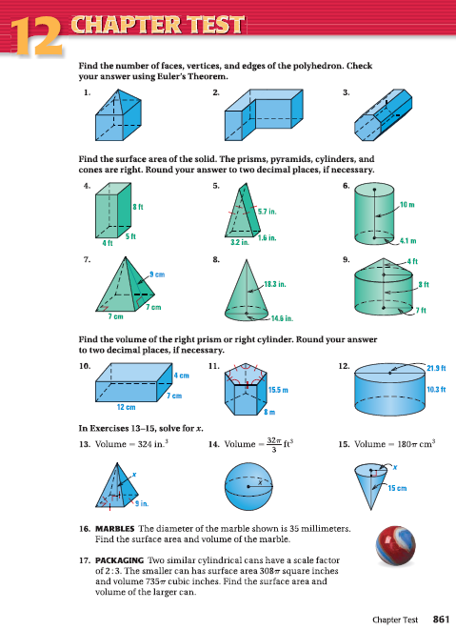
12.Review
861 #1-17 all = 17

